Slide 1

2026 National Electrical Code (NEC) Changes
Itinerary
2026 NEC:
Recap
Next Session
chapter 3 wiring methods & materials (F
Chapter 4 equipment for general use
chapter 5 specific occupancies & locations
Chapter 6 special equipment

Slide 2
Recap
Definition revisions:
  Energy Storage Systems
  Metering Center
  Pool
  Permanently Installed Pool
Art 110:
  Arc-Flash Hazard Warning Signs
  Space Around Electrical Equipment
Art 120:
  Dwelling Unit Calculations
  Number of Branch Circuits for Dwelling Units
  Electric Vehicle Supply Equipmenrt

Slide 3
Recap
Art 210:
Ground-Fault Circuit Interrupter Protection for Personnel
Garages & Accessory Buildings
Dwelling Units
Other Than Dwelling Units
Outdoor Outlets at Dwelling Units
Equipment Requiring Servicing
Art 225:
  Building Disconnect Means
  Location
Art 230:
  Surge Protection
  General

Slide 4
Recap
Art 240:
Location
Art 250:
  Grounding and Bonding Connections
  Grounding Electrode Conductor Installation

Slide 5
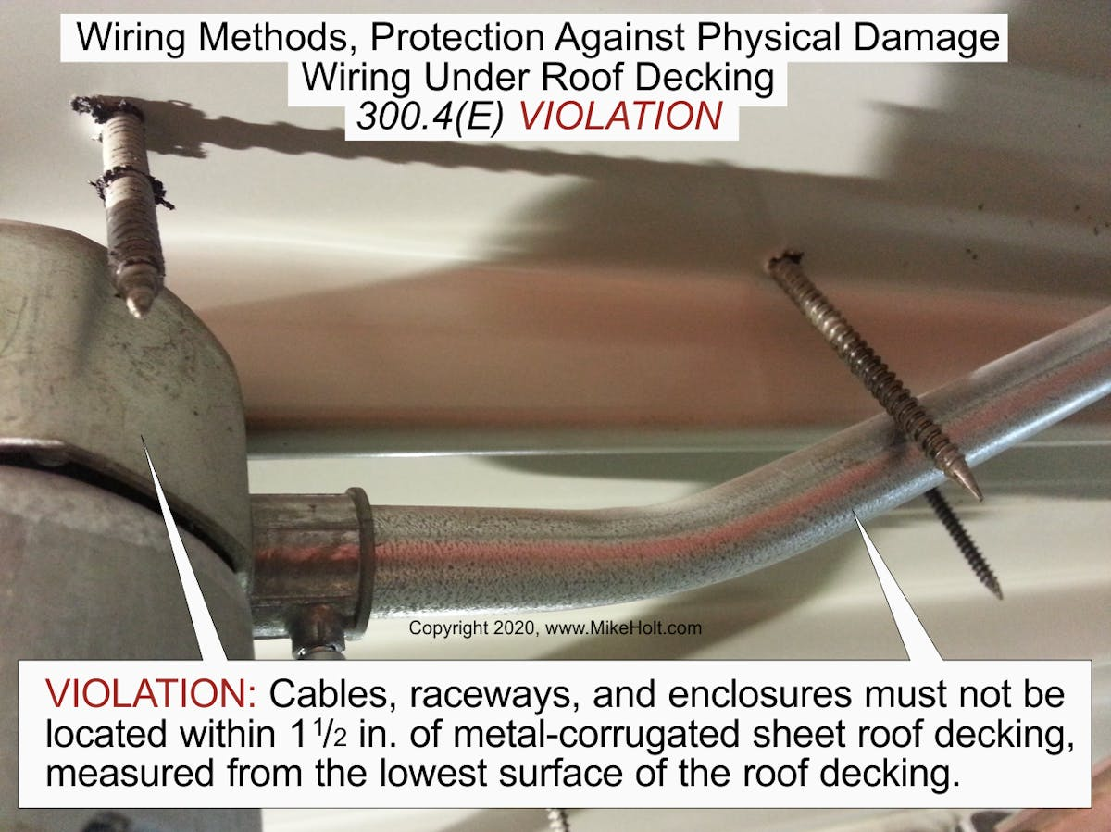
2026 National Electrical Code (NEC) Changes
Article 300.6 Protection Against Physical Damage
Requirements expanded and clarified
6
300.6(E) Wiring Methods and Materials in or Under roof Decking
Wiring methods and materials under roof decking must be at least 1 ½” below the decking.
Wiring is not allowed in concealed locations within metal corrugated sheet decking-type of roofs unless allowed by exception.
Info Note: This ensures that screws used for roofing material do no damage the wiring system during the initial installation or when the roof is replaced.

Slide 6
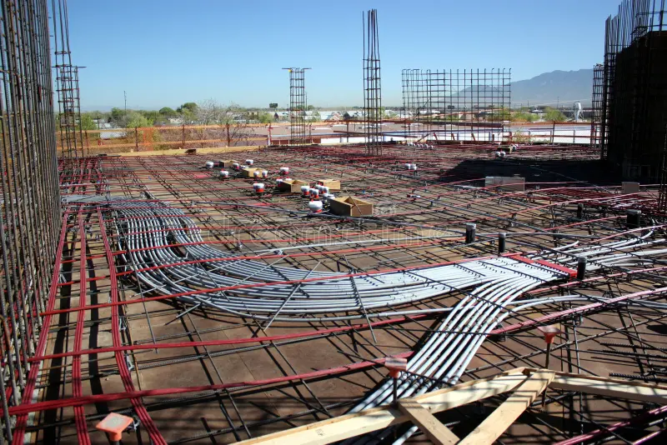
2026 National Electrical Code (NEC) Changes
Article 300.6 Protection Against Physical Damage
Requirements expanded and clarified
300.6(E) Wiring Methods and Materials in or Under roof Decking
Ex 3: Wiring methods and materials may be concealed in concrete that is at least 2” thick, and the accessibility requirements for boxes and conduit bodies in 314.29 must be followed.

Slide 7
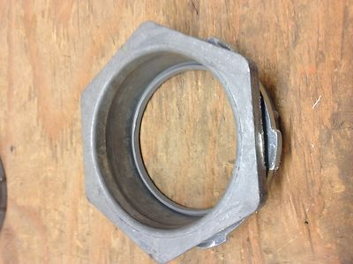
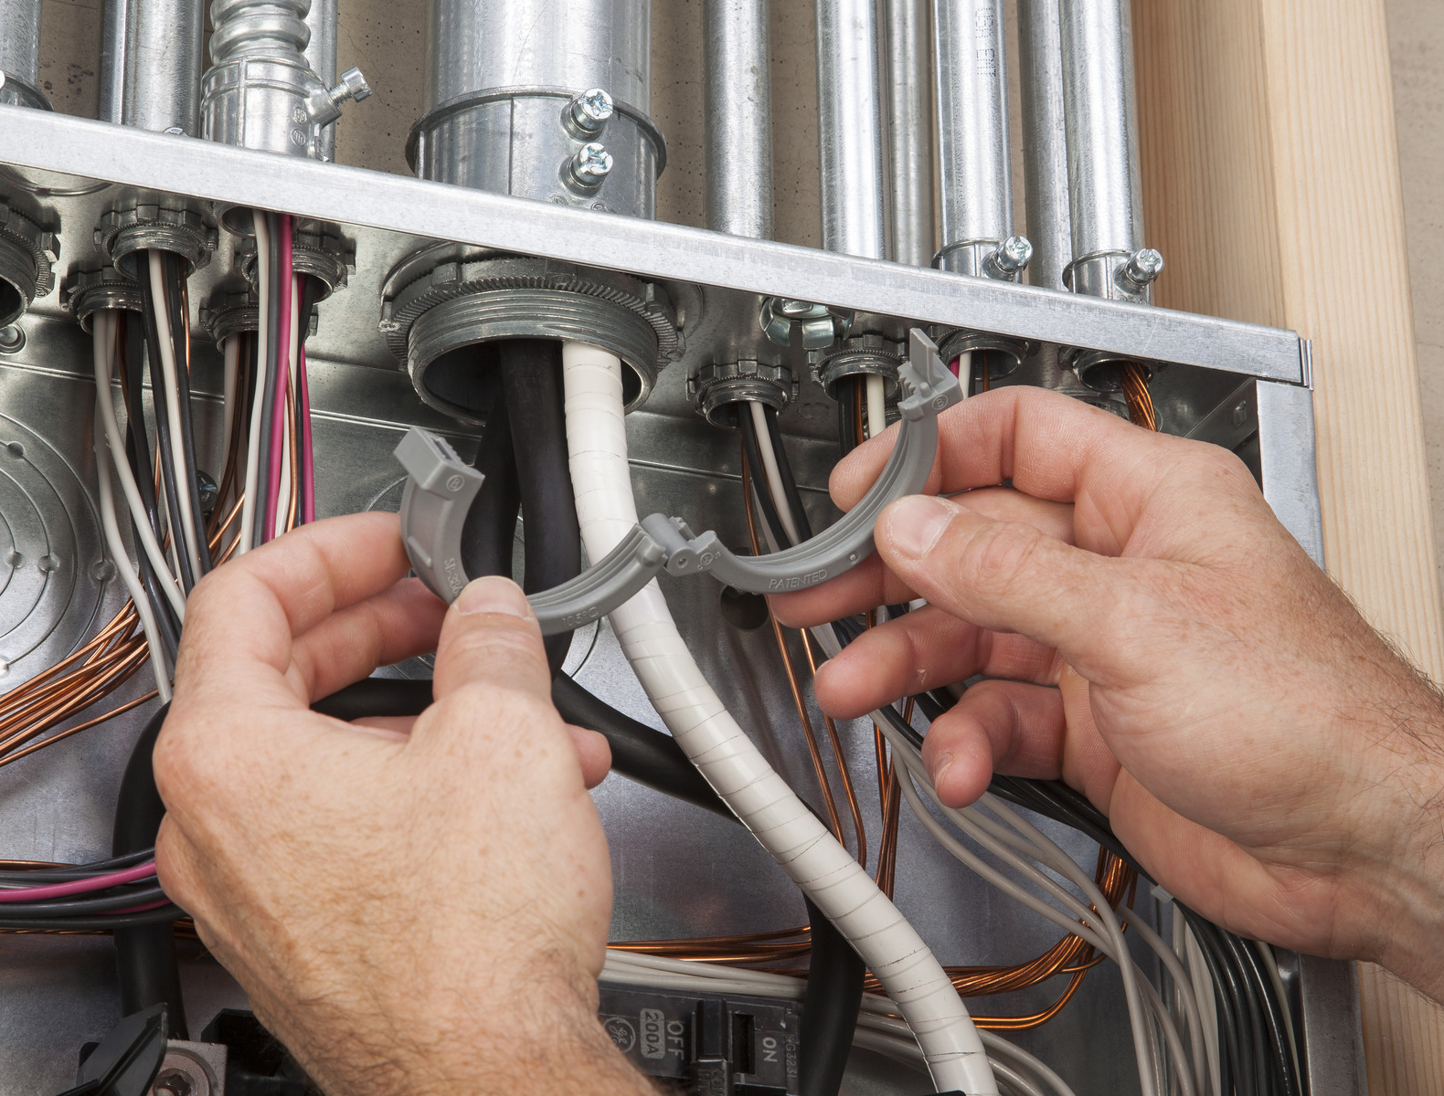
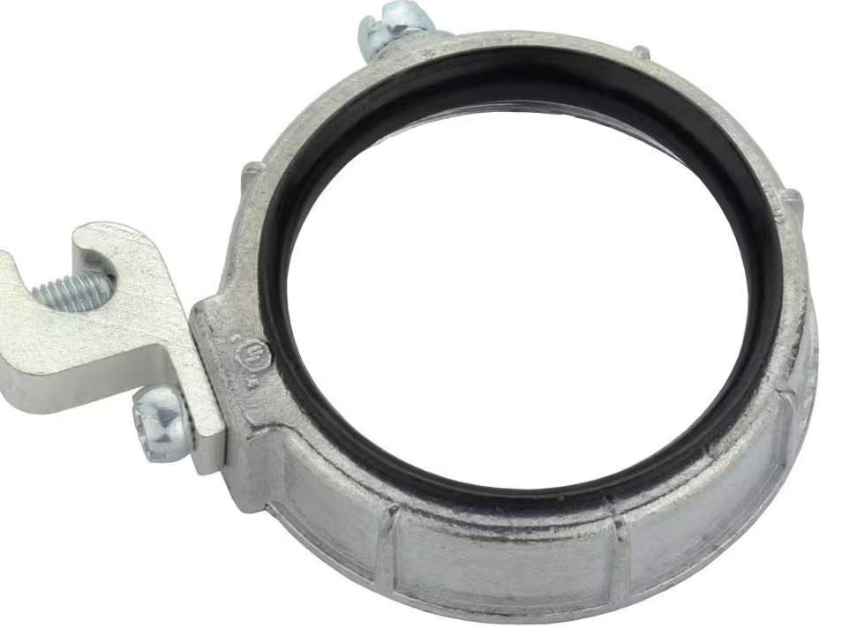
2026 National Electrical Code (NEC) Changes
Article 300.6 Protection Against Physical Damage
Requirements expanded and clarified
300.6(G) Fittings
Raceways with circuit conductors 4 awg or larger must have one of the following, instsalled prior to the installation of the conductors, to protect the conductor insulation:
(1) An identified fitting with a smoothly rounded insulating surface.
(2) A listed metal fitting with smoothly rounded edges.
(3) Separation from the fitting or raceway with an identified insulating material that is secured in place.
(4) Threaded hubs or bosses that are an integral part of the enclosure or raceway and provide a smoothly rounded or flared entry for conductors.

Slide 8
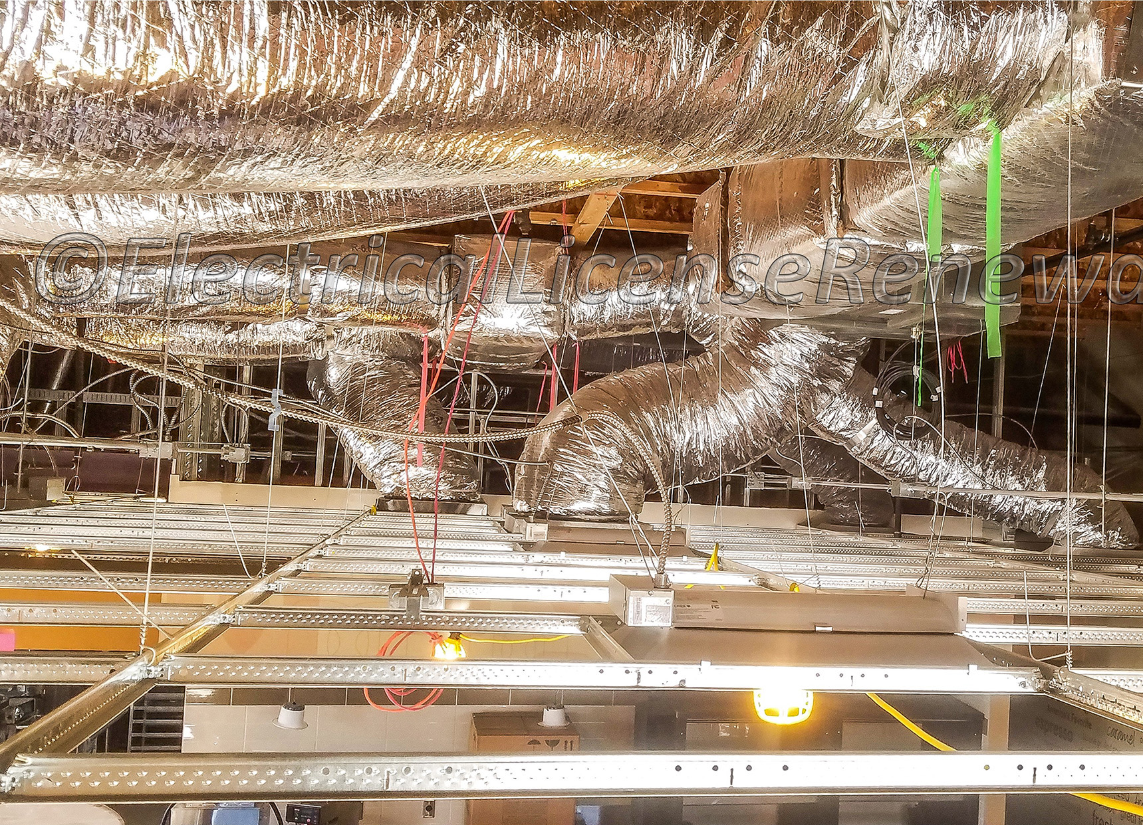
2026 National Electrical Code (NEC) Changes
Article 300.13 Securing and Supporting
Requirements above suspended ceilings, bonding jumpers, conductor support, and cable tie requirements.
300.13(B)(1) General
Cables and raceways are not allowed to be suspended by the ceiling grid itself, or by its support wires.

Slide 9
2026 National Electrical Code (NEC) Changes
Article 300.13(B)(2) Independent Support Wires
Ceiling grid wires may be used for support if they (all):
(1) Are in addition to those required for the ceiling.
(2) Are marked by color, tagging, or other effective means.
(3) Are secured at the top and bottom.
(4) Provide secure support.
Ex 1: The ceiling grid may support electrical equipment if tested as part of the fire-resistant rating of the ceiling grid system.
Ex 2: If the ceiling grid instructions allow electrical equipment to be supported by the grid, the grid may be used for support.

Slide 10
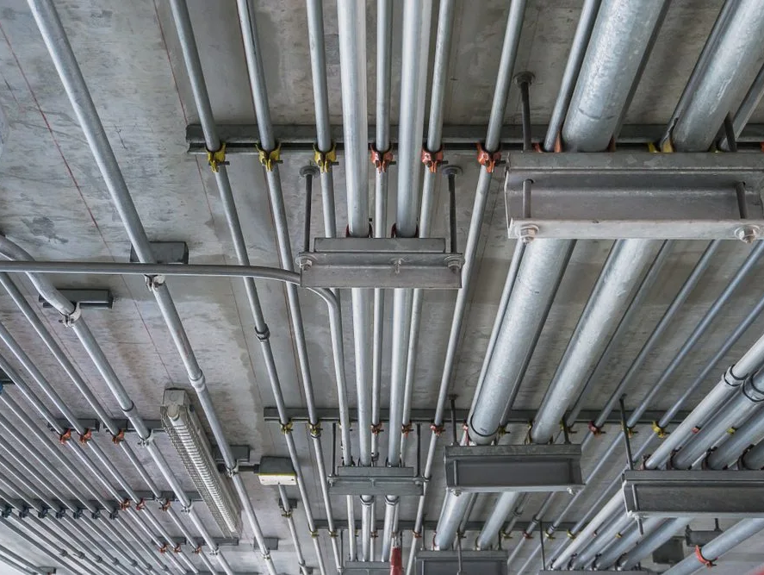
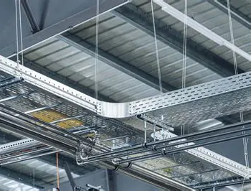

2026 National Electrical Code (NEC) Changes
Article 300.13(C) Raceways for Support
Raceways are not allowed to support other raceways, cables, or other equipment, unless allowed by (1)-(4)
Is a cable tray a raceway?
(1) The raceway or support is identified for supporting.
(2) The raceway supplies a piece of equipment and supports a class 2 or 3 cable that controls that piece of equipment.
A cable tray is defined as a support system for wire and cable, not a raceway.
(3) The raceway supports enclosures or luminaires as allowed in 314.23 and 410.36(E).
(4) The raceway supports an equipment bonding jumper for the circuits within the raceway.

Slide 11
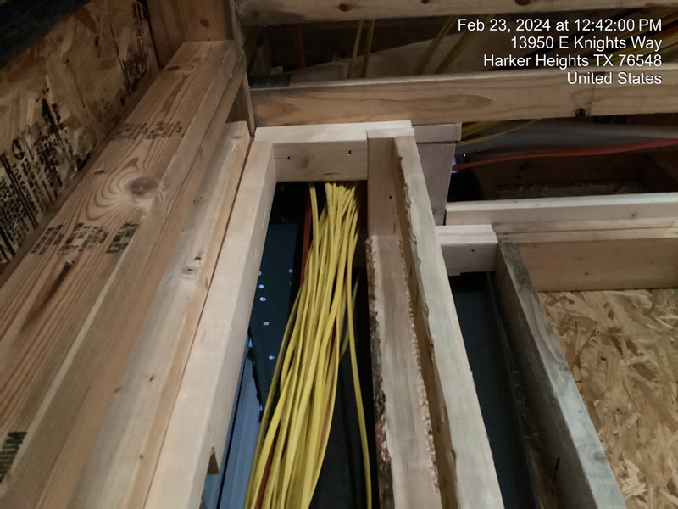
2026 National Electrical Code (NEC) Changes
Article 300.13(D) Cables for Support
Cable or individual conductor wiring methods are not allowed to support any wiring or other equipment, electrical or otherwise.

Slide 12
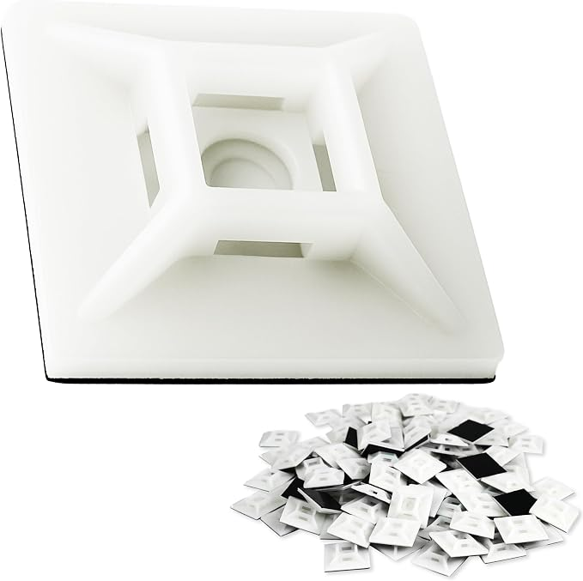
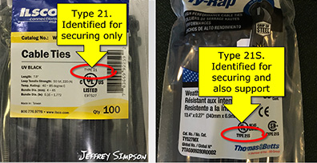
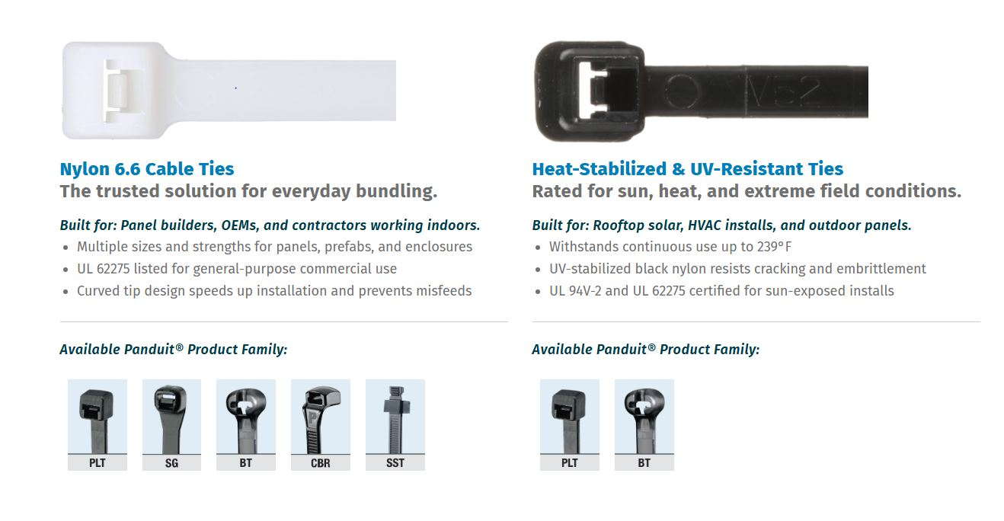
2026 National Electrical Code (NEC) Changes
Article 300.13(E)(1) Cables Ties
If cable ties are used to secure and support flexible conduit, flexible tubing, or cables, they must be listed and be identified for securing and supporting.
Info Note: Types 2S and 21S are for securing and supporting cables, flexible tubing, and flexible conduit.
Cable tie fixing devices must be listed and be identified for securing and supporting.

Slide 13
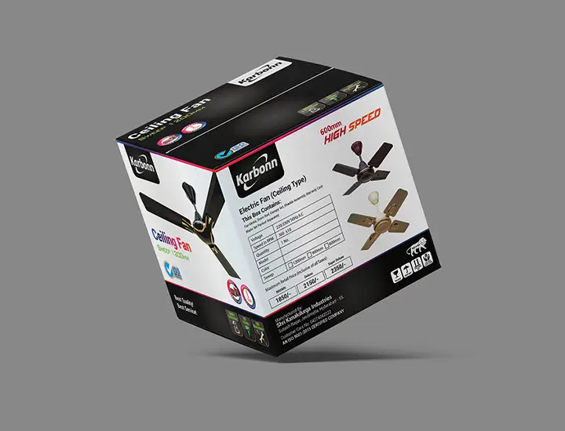
2026 National Electrical Code (NEC) Changes
Article 314.27 Outlet, Device, Pull, and Junction Boxes; Conduit Bodies; Fittings, and Handhold Enclosures
Requirements for fan boxes in dwellings clarfied and reduced.
314.27(B)(1) General
(1) Boxes that support ceiling suspended paddle fans must be listed and (1) be marked by the manufacturer on the box’s exterior,
(2) Be marked with their maximum rating if more than 35lbs,
(3) May never support fans heavier than 70lbs.

Slide 14
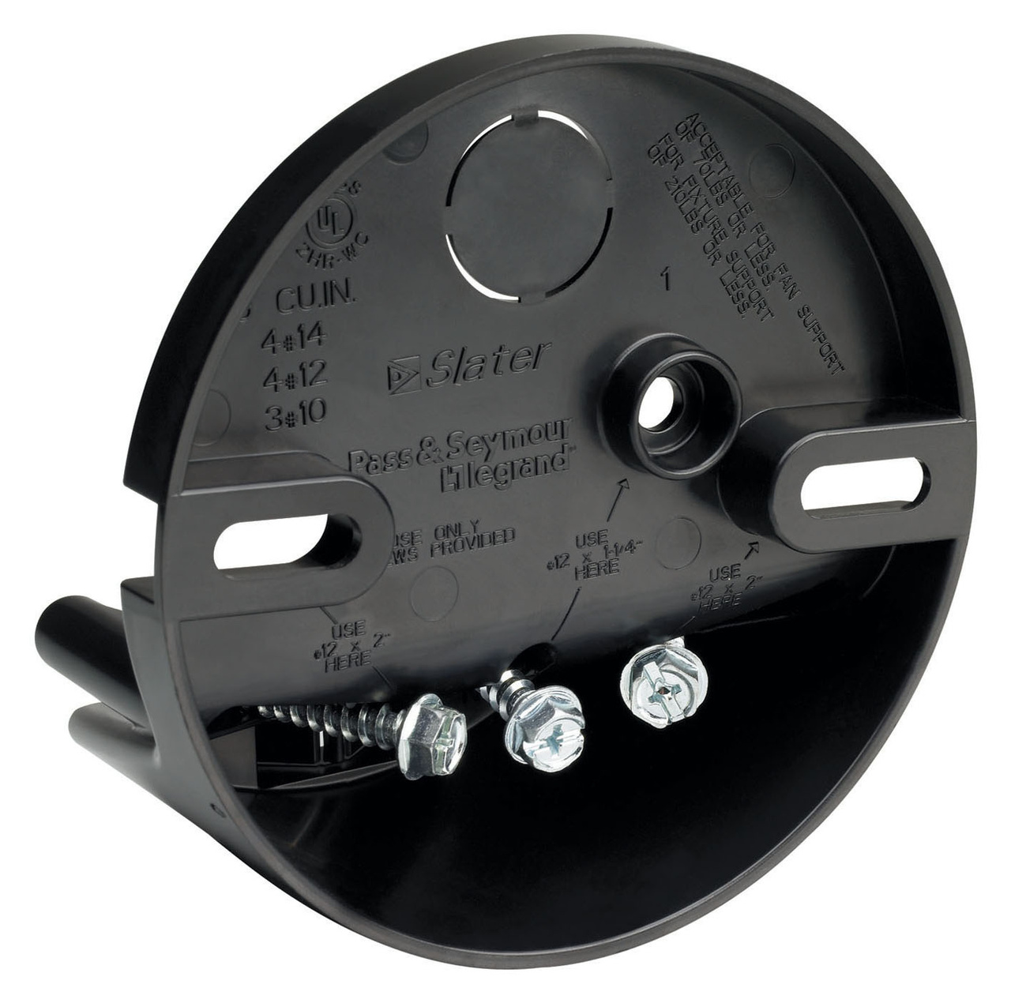

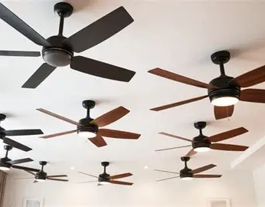
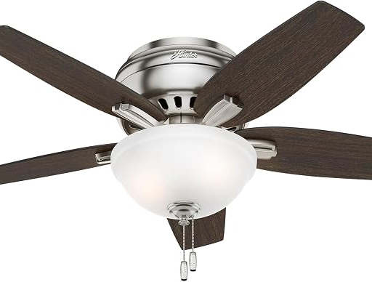
2026 National Electrical Code (NEC) Changes
Article 314.27 Outlet, Device, Pull, and Junction Boxes; Conduit Bodies; Fittings, and Handhold Enclosures
Requirements for fan boxes in dwellings clarfied and reduced.
No longer required in a kitchen.
314.27(B)(2) Required Locations
In living and sleeping areas of dwelling units, ceiling outlet boxes that are centrally mounted in locations typical for a ceiling fan, and boxes indicated by the designer, installer, or owner for a ceiling fan must:
(1) Be listed for the sole support of ceiling fans, or
(2) Be installed in a way that allows a fan to be directly supported by the structure without removing the box.

Slide 15
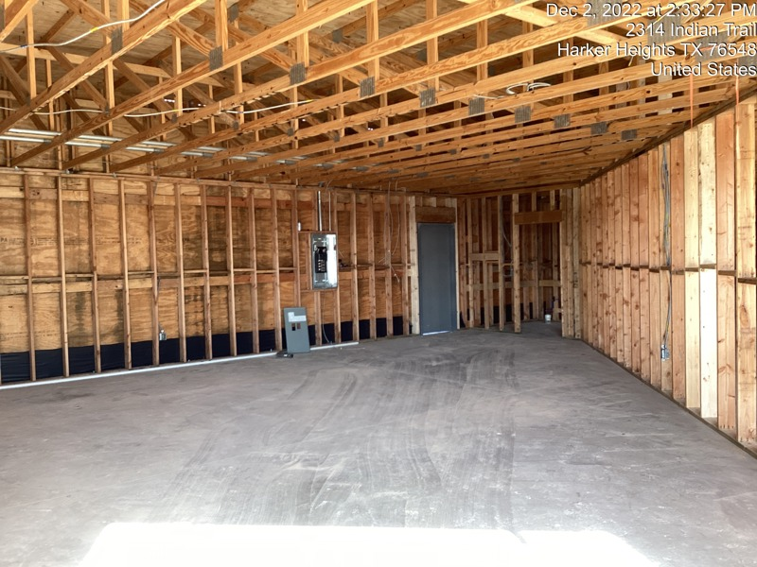

2026 National Electrical Code (NEC) Changes
Article 334 Nonmetallic-Sheathed Cable: Types NM and NMC
Use of NM cable in other than dwellings was clarified and expanded.
What does our ordinance say?
334.10 Uses Permitted
150.02(K)(2)(A)3(a)-(f) Types NM, NMC, and NMS. Types NM and NMS cables shall not be used as follows
(3) Other than dwellings allowed to be Type III, IV, or V construction, if concealed installed in walls, floors, or ceilings that provide at least 15-minute finished rating.
In any of the following types of occupancies:
Apartment houses of two stories of occupancies or greater.
Any commercial building.
Any industrial building.
Educational buildings.
Churches and church accessory structures.
Public buildings.
Ex to (3): Cables may be installed without the 15-minute finish rating in Type V storage buildings or in storage garages at grade level that are less than 1,500 sq ft.

Slide 16
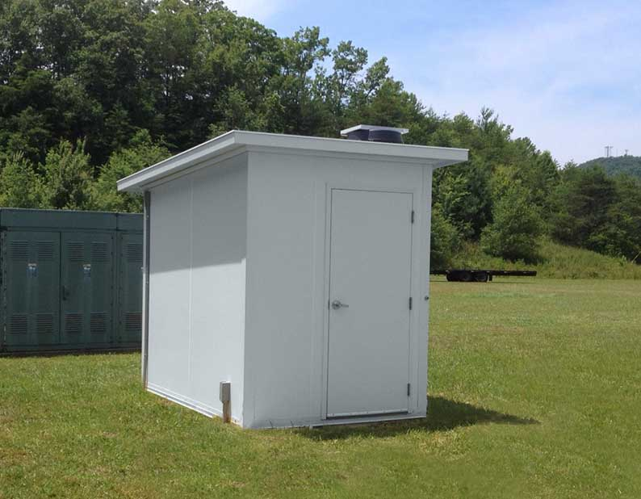
2026 National Electrical Code (NEC) Changes
Article 334 Nonmetallic-Sheathed Cable: Types NM and NMC
Use of NM cable in other than dwellings was clarified and expanded.
334.10 Uses Permitted
(3) Other than dwellings allowed to be Type III, IV, or V construction, if concealed installed in walls, floors, or ceilings that provide at least 15-minute finished rating.
Ex to (3): Cables may be installed without the 15-minute finish rating in Type V storage buildings or in storage garages at grade level that are less than 1,500 sq ft.

Slide 17
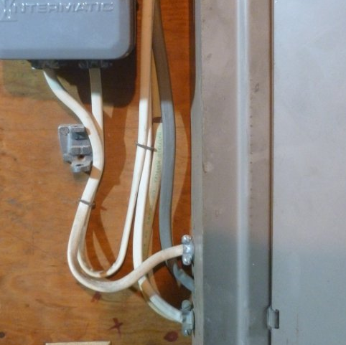
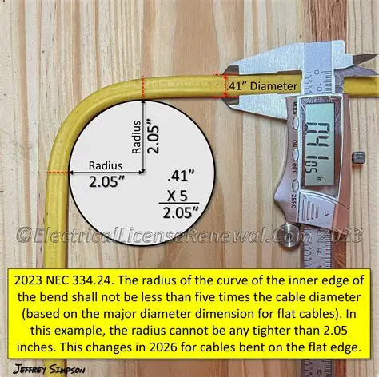
2026 National Electrical Code (NEC) Changes
Article 334.24 Bending Radius
Nonmetallic-Sheathed Cable: Types NM and NMC beding radius requirements clarified and reduced the same as Art 338 SE cable and 340 UF cable.
334.10 Bending Radius
Bends must not damage the cable sheath. The inner radius of the curve of a bend must be at least five times the widest cable diameter.
For flat cables, the smallest dimension of the cable is used when bending the flat side. For other bends, the wider dimension is to be used for the diameter.

Slide 18
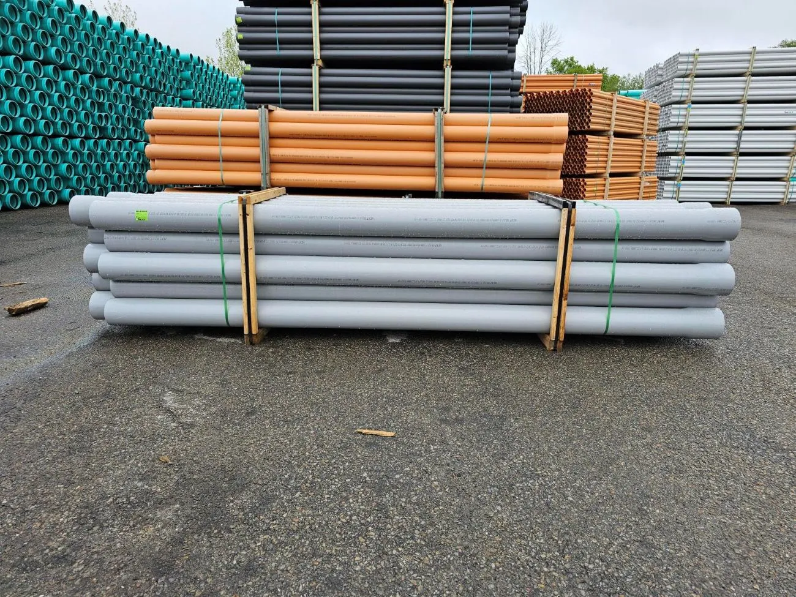
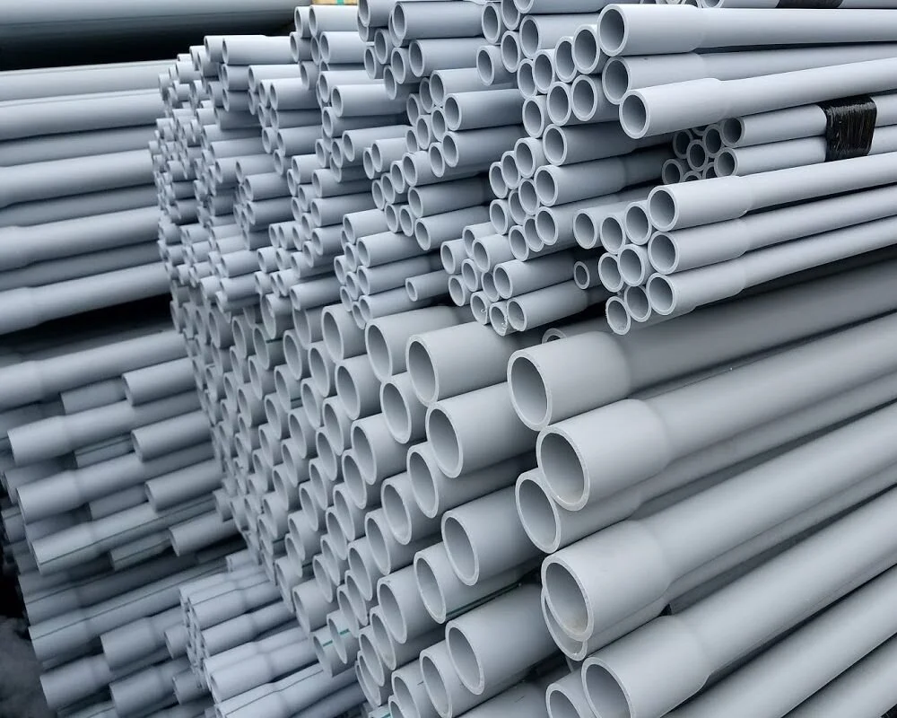
2026 National Electrical Code (NEC) Changes
Article 352 Nonmetallic Conduits
Larger Rigid Polyvinyl Chloride Conduit (PVC) conduit permitted in certain uses the same as Art 353 HDPE conduit and Art 355 RTRC conduit.
Must be listed
352.20 Sizes
Minimum. The smallest size PVC allowed is trade size ½.
Maximum The largest size PVC allowed is trade size 6.
Ex: Larger sizes are allowed if:
(1) No portion of the raceway is aboveground,
(2) It is backfilled as required in 300.7,
(3) It is not in a hazardous classified location, and
(4) The raceway fill requirements of Chapter 9 are satisfied.

Slide 19
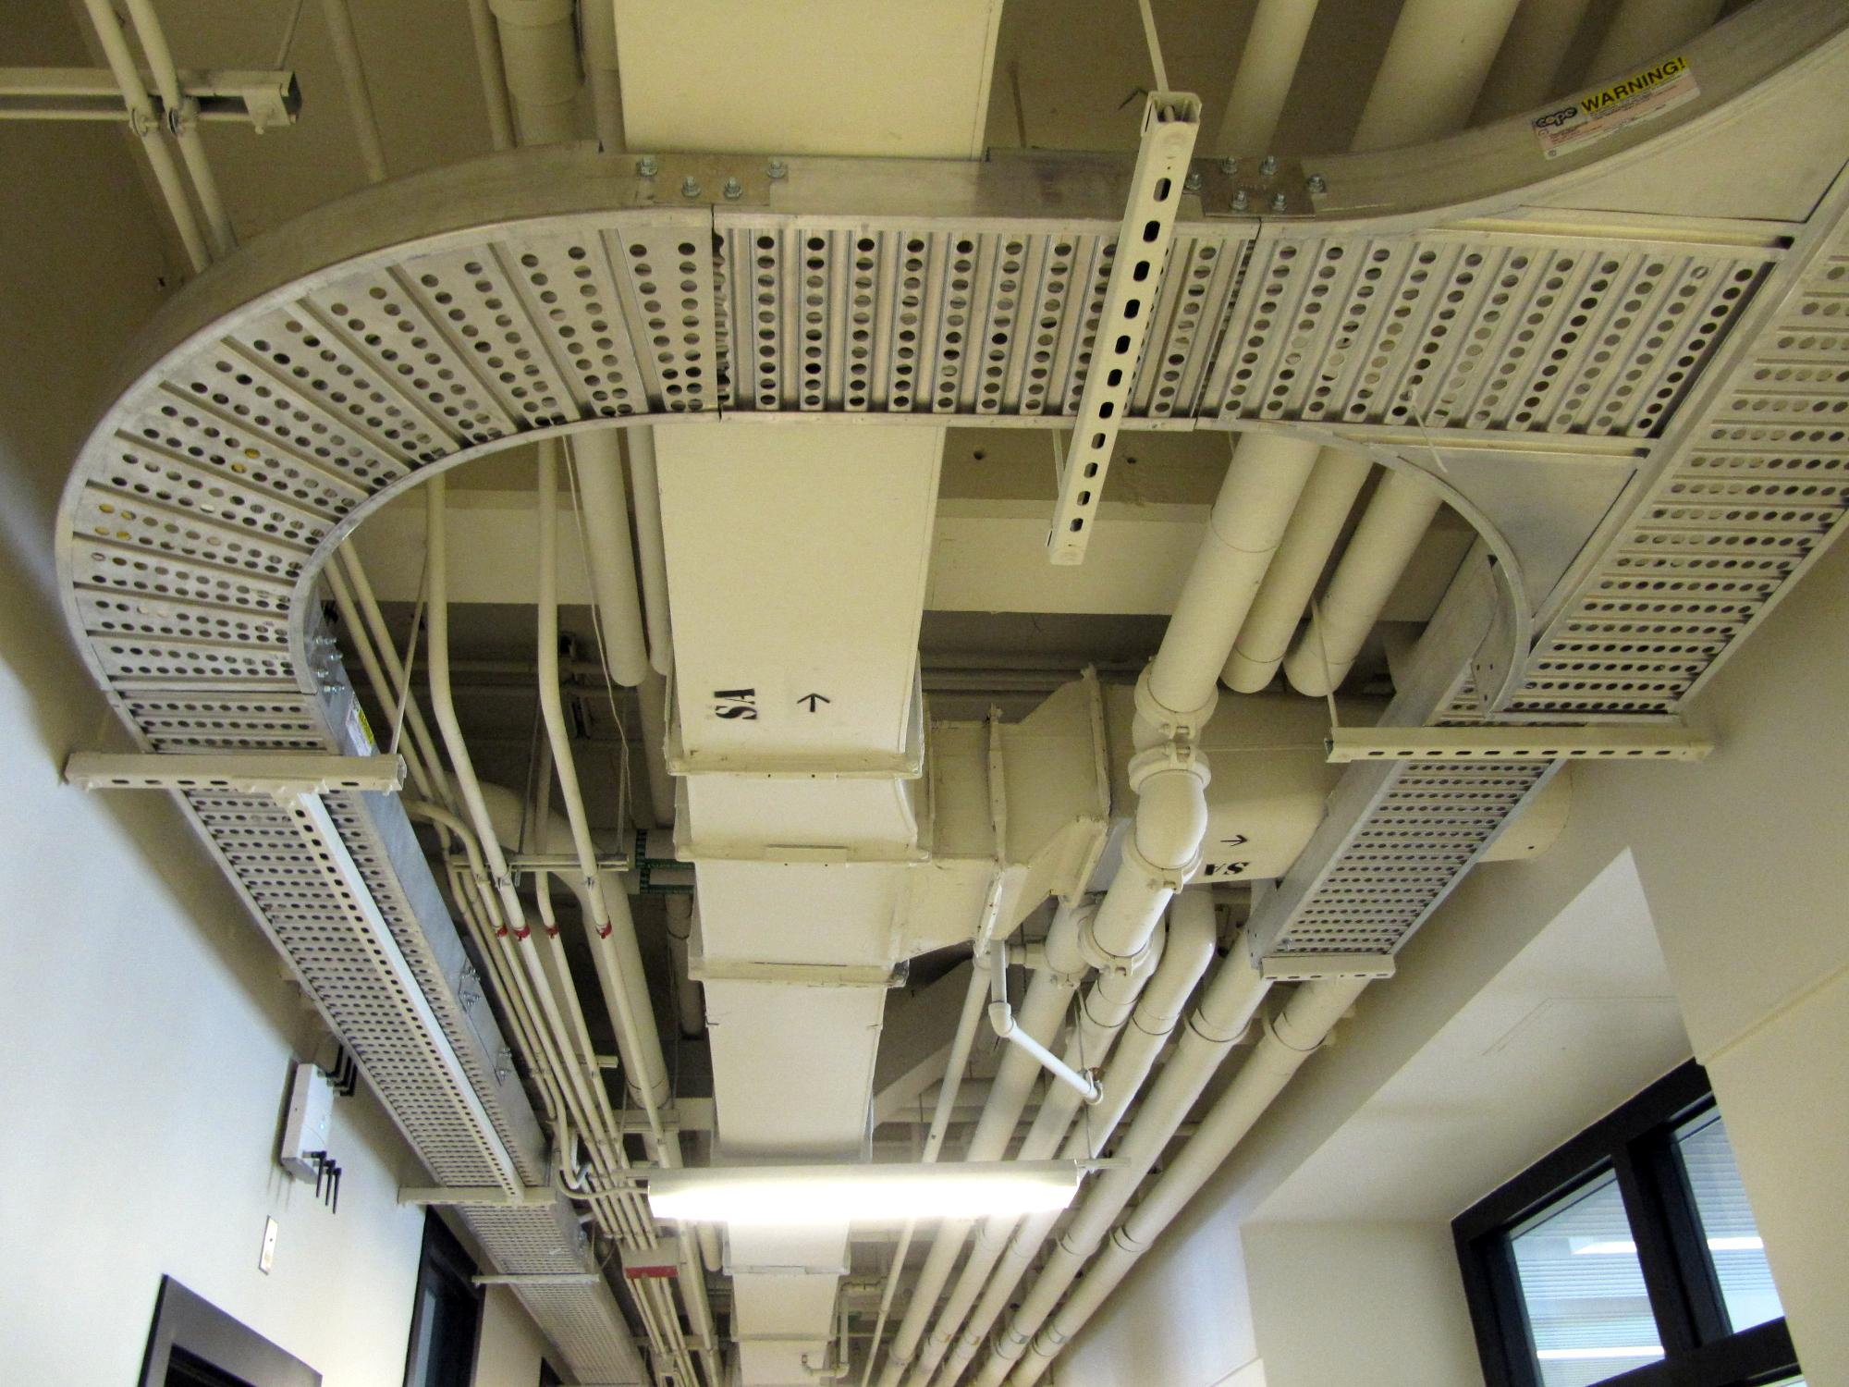
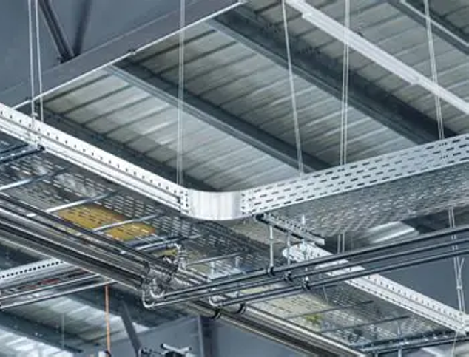
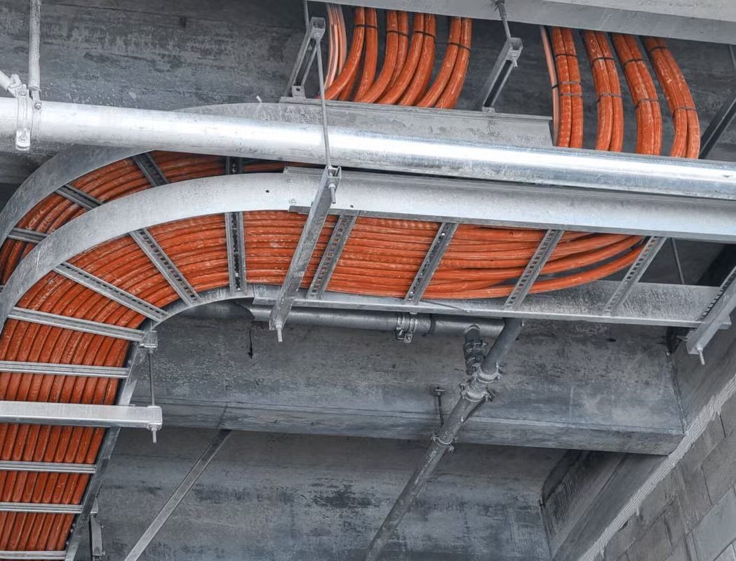
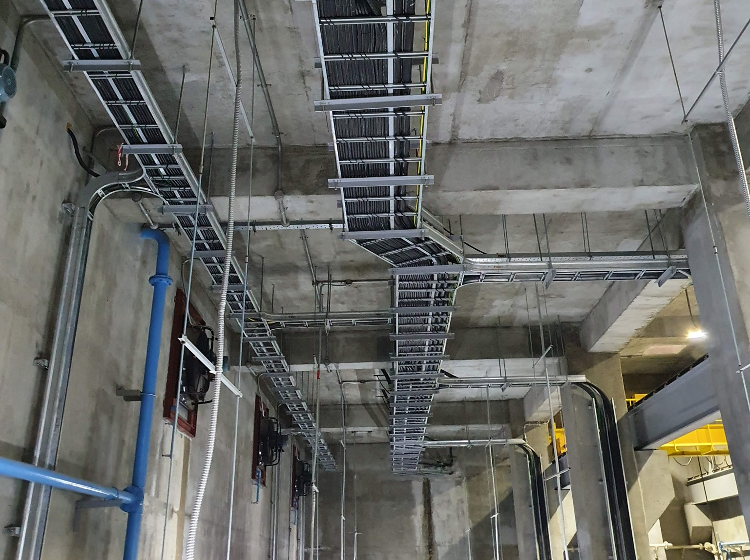

2026 National Electrical Code (NEC) Changes
Article 392.18 Cable Trays
Free space requirements added.
12”
392.18(F) Access
At least 12” of free space is required above cable trays shall be provided and maintained to permit access for installing and maintaining cables.
Ex 1: Where the installation complies with 645.5 for IT equipment room.
Ex 2: In industrial establishments, were conditions of maintenance and supervision ensure that only qualified persons service the installed cable tray.
Ex 3: By special permission, smaller distance spaces shall be permitted.
Ex 4: For equipment crossing at an angle.

Slide 20
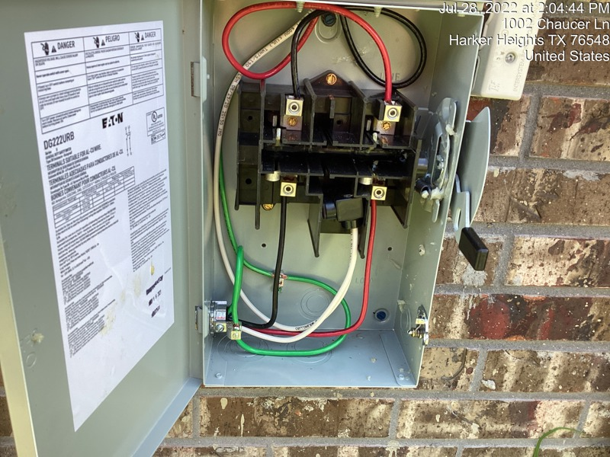

2026 National Electrical Code (NEC) Changes
Article 404.30 Switch Enclosures with Hinged Covers or Doors
Requirement expanded for protection of live parts in switch enclosures
Switches within enclosures that have doors or hinged covers must be dead front, unless a tool is required to access the interior or the enclosure.

Slide 21
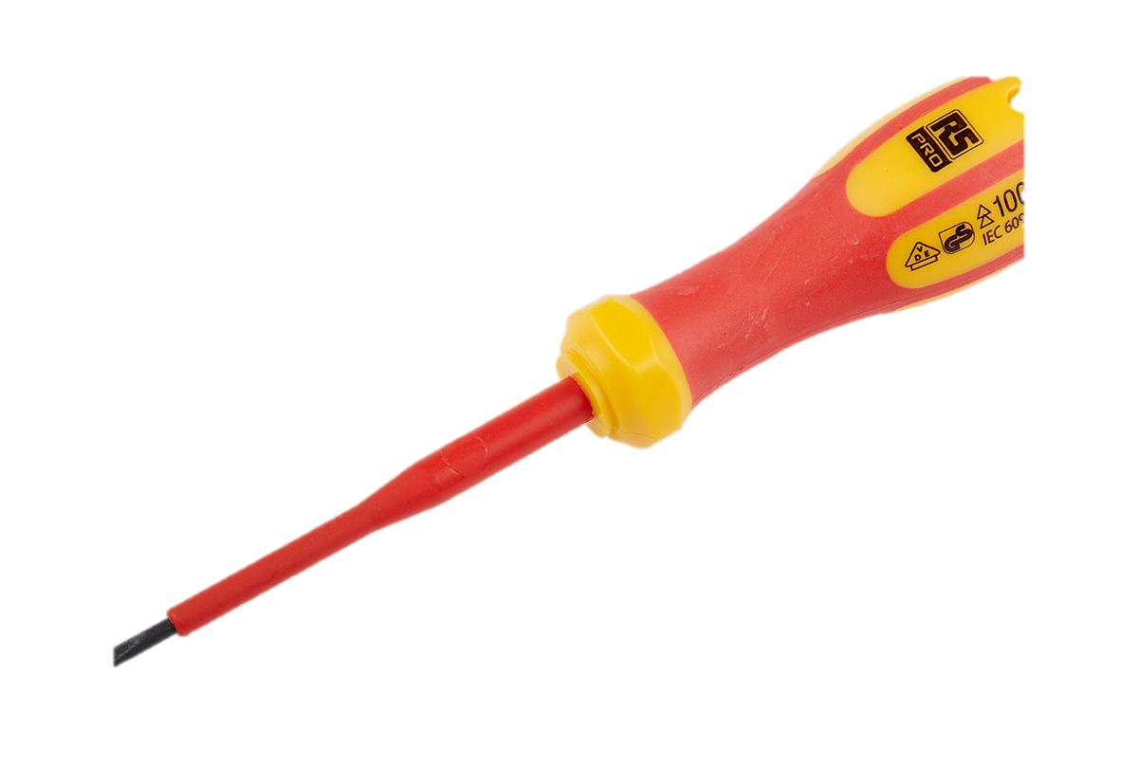
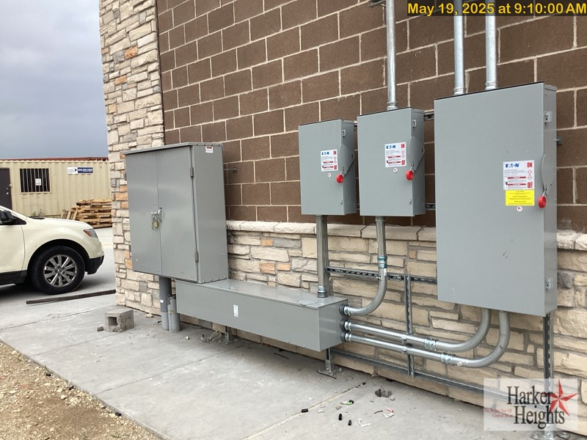
2026 National Electrical Code (NEC) Changes
Article 404.30 Switch Enclosures with Hinged Covers or Doors
Requirement expanded for protection of live parts in switch enclosures
Switches within enclosures that have doors or hinged covers must be dead front, unless a tool is required to access the interior or the enclosure.

Slide 22
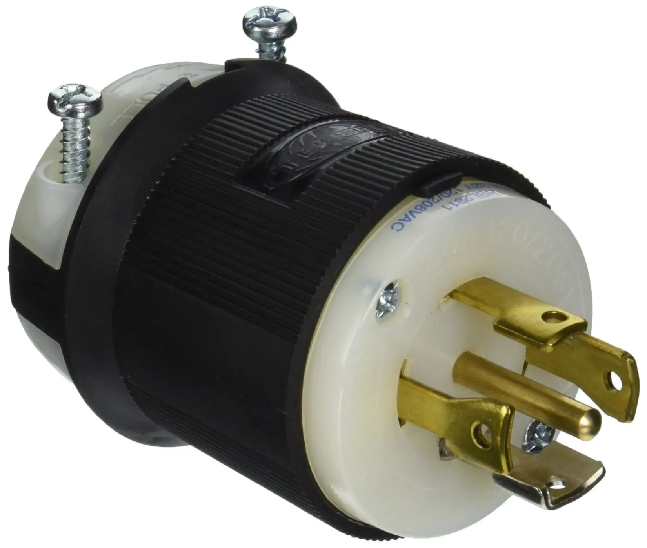
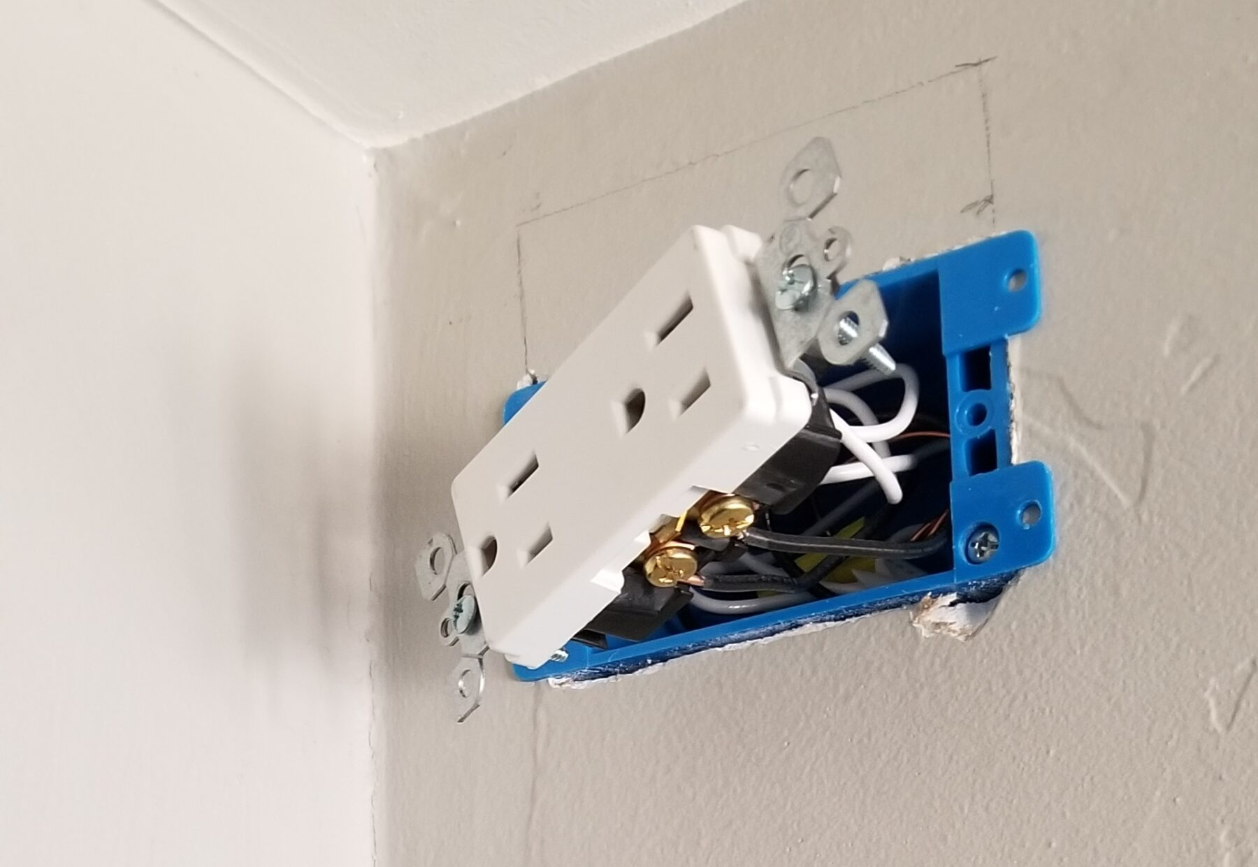
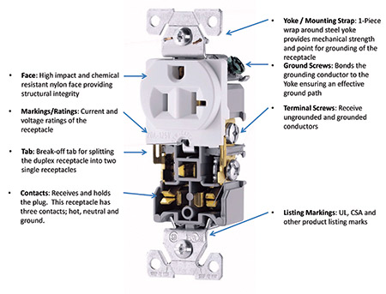
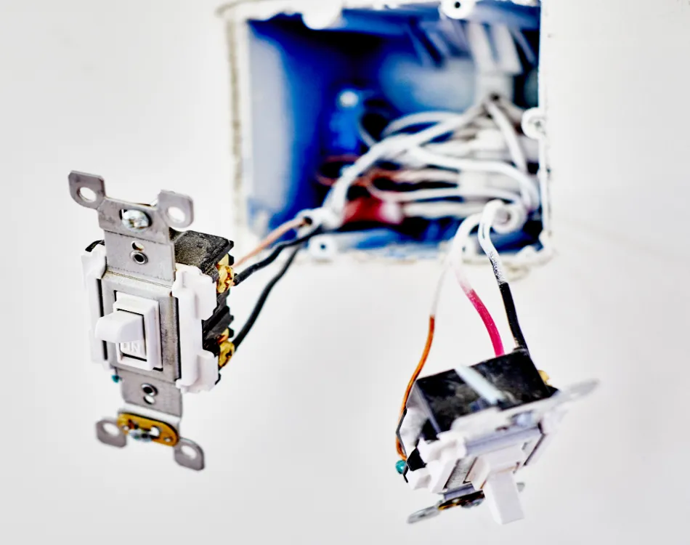
2026 National Electrical Code (NEC) Changes
Article 406 Wiring Device
New definition added.
New definition of yoke added also.
Article 100: Wiring Device
A device that has a yoke or is connected to a flexible cord in branch circuits or general distribution as a connection point or control device.
Examples include general-use snap switches, receptacles, dimmers, attachment plugs, surface switches, and similar.

Slide 23
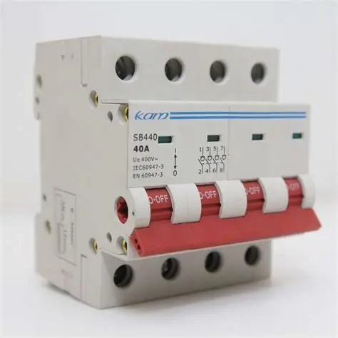
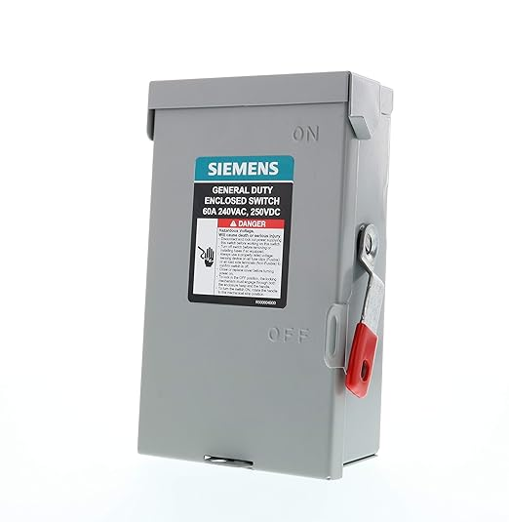
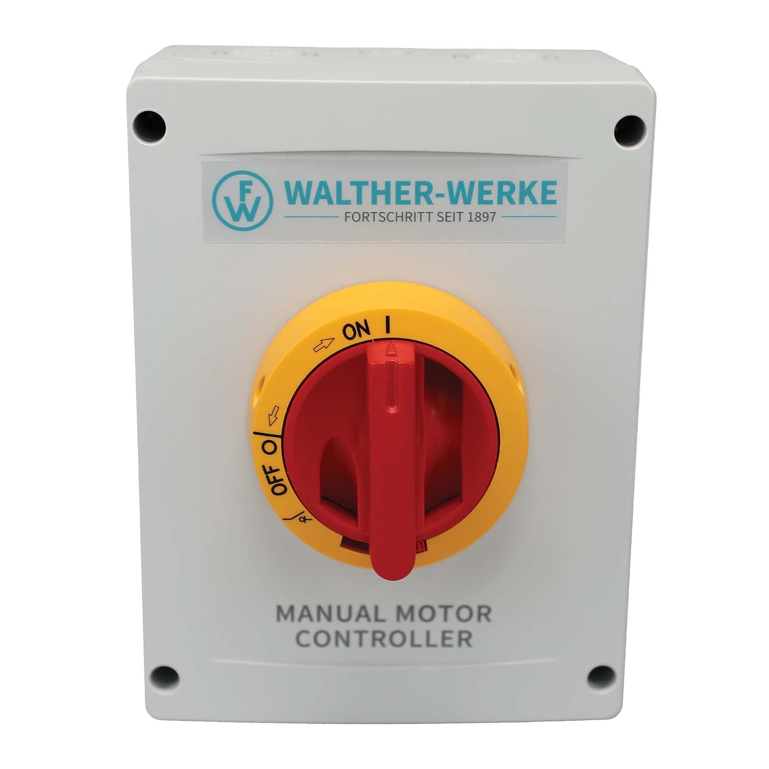
2026 National Electrical Code (NEC) Changes
Article 406.1 Scope
Revised with general-use snap switches and similar small switches.
Article 406 now covers wiring devices.
Article 404.1 Scope no longer covers general-use snap switches, dimmers, and similar wiring devices.
Article 404.1(A) Covers
Covers motor-circuit switches, isolating switches, general-use switches, circuit breakers used as switches, molded case switches, and pullout switches for systems up to 1,000v.
Article 404.1(B) Not Covered
(1) Article 404 does not cover wireless control equipment that is not connected to circuit conductors.
(2) Article 404 does not cover wiring devices. Info Note: See Article 406 for wiring devices.

Slide 24
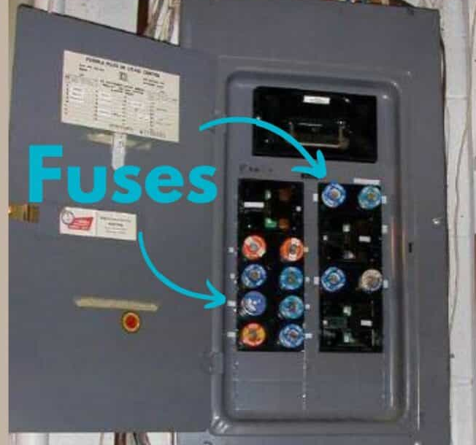
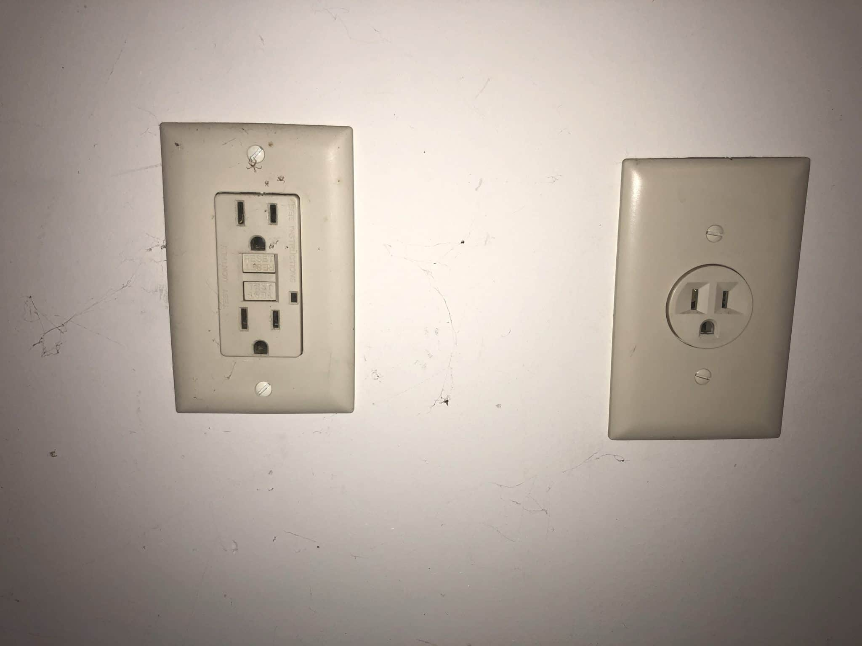
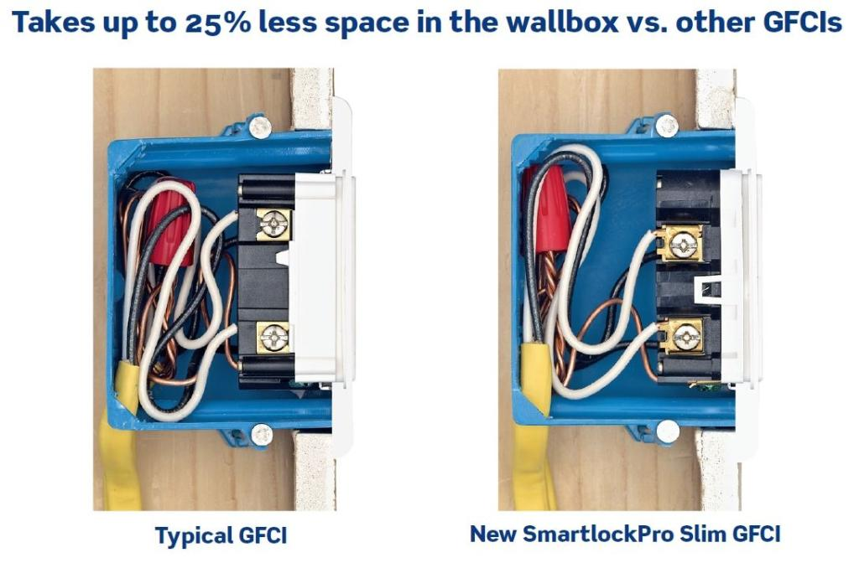
2026 National Electrical Code (NEC) Changes
Article 406.12 General Requirements
The allowance for replacing receptacles without GFCI reduced.
Is the outlet box to small?
Is the box upstream or downstream?
Article 406.12(D)(3) GFCI Protection
Replacement receptacles must comply with the following requirements. AFCI or GFCI type receptacles must be installed in readily accessible locations.
This is the upstream outlet box.
Ex 1: The outlet box size will not permit installation of a GFCI receptacle.
Ex 2: No electrically upstream outlet box will permit installation of a GFCI receptacle.
Ex 3: A GFCI circuit breaker cannot provide the required GFCI protection.

Slide 25

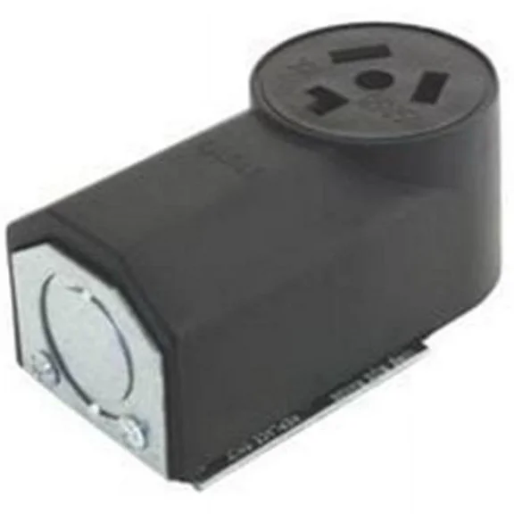
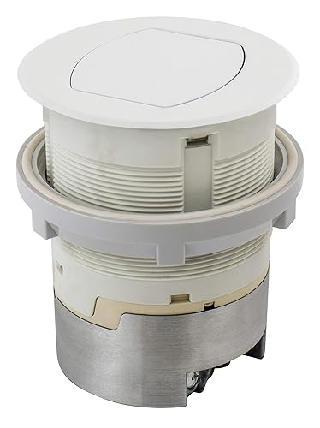
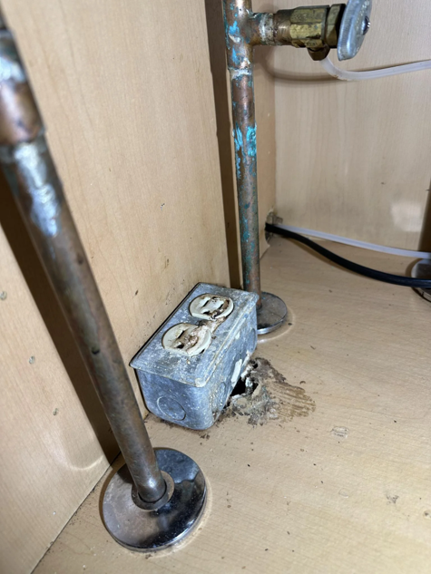

2026 National Electrical Code (NEC) Changes
Article 406.14 Mounting of Receptacles
Laundry receptacles can not be installed facing up.
Article 406.14(G) Receptacle Orientation
Receptacles are not allowed facing upward:
(1) In or on countertops or work surfaces unless listed for them.
Does this include receptacles for ranges?
(2) Beneath a sink.
(3) In laundry areas, unless listed for work surfaces or countertops, as appliable.

Slide 26
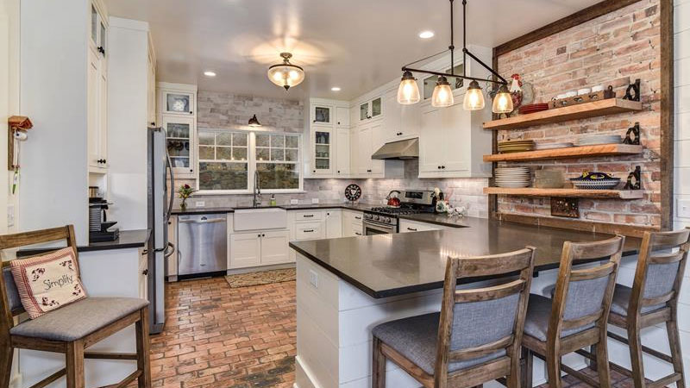

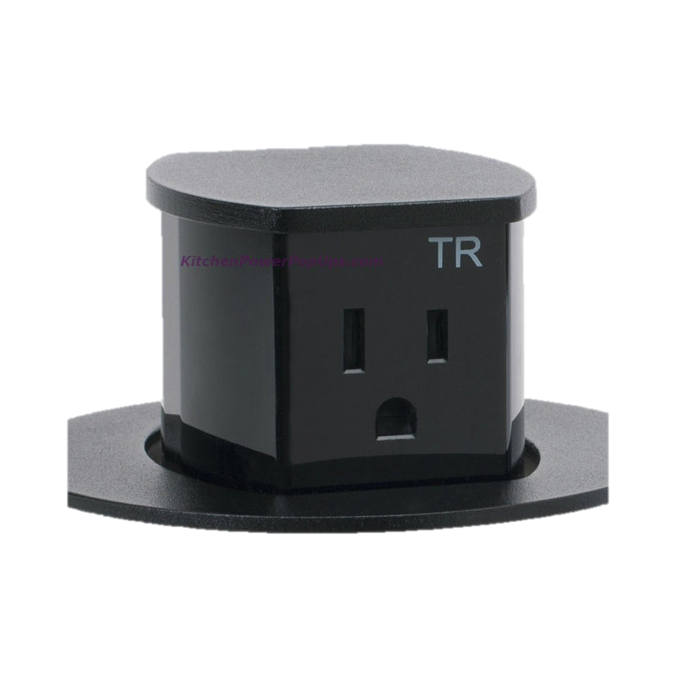
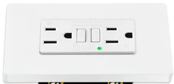

2026 National Electrical Code (NEC) Changes
Article 210.52(C)(3) Location
Receptacle outlets must be in one of the following locations:
(1) On or up to 20” above the countertop or work surface.
(2) Receptacle outlet assemblies listed for use in countertops may be installed in countertop or work surface areas.
Facing up
…must be listed for countertop (32oz spill test) not work surface (8oz spill test).
(3) Receptacle outlet assemblies listed for use in countertops or work surfaces may be installed in work surfaces.

Slide 27
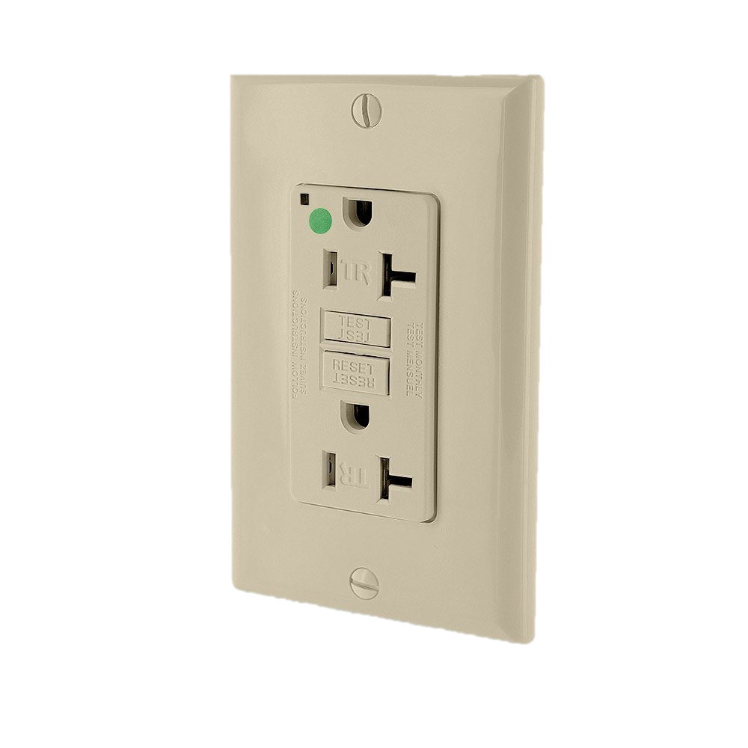
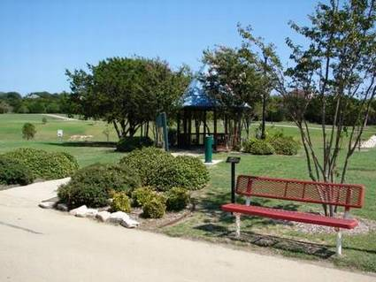
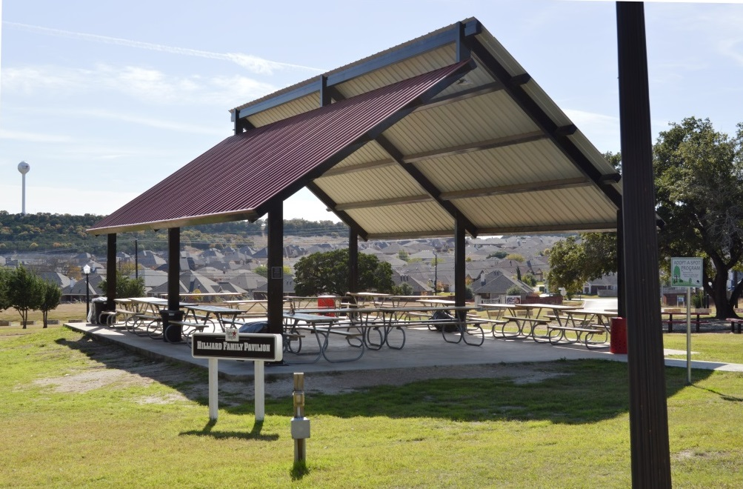
2026 National Electrical Code (NEC) Changes
Article 406.26 Tamper-Resistant Receptacles
Receptacles in park and recreation areas must be tamper-resistant
All 15A and 20A, 125v and 250v n0nlocking receptacles in the following locations must be listed as tamper-resistant.
(11) Park and recreation areas.
Info Note 4: Park and recreation areas could include play areas, garden areas, and similar locations.

Slide 28
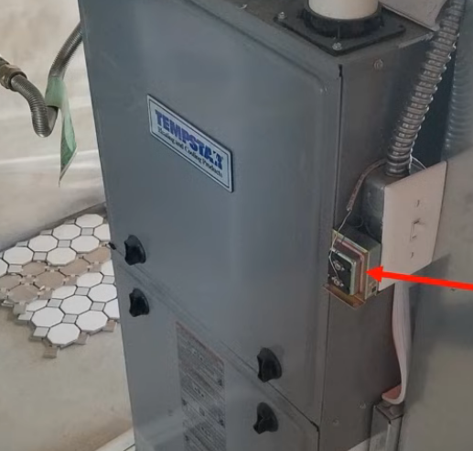
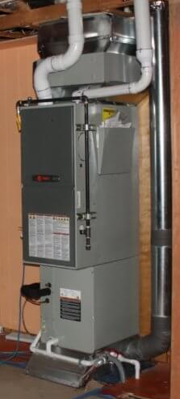

2026 National Electrical Code (NEC) Changes
Article 422.12 Central Heating Equipment
Types of equipment allowed has been expanded.
Note: Article 424 covers electric central heating equipment.
Central heating equipment, other than fixed electric space-heating equipment, must be supplied by an individual branch circuit.
Ex1: Auxiliary equipment, such as a humidifier, pump, air cleaner, or similar equipment, that is directly associated with the heating equipment, may be on the heating circuit.
Class 2 transformer for doorbell is not similar equipment.
Ex2: Permanently installed air-conditioning equipment, lighting outlets required by 210.70(C), and receptacle outlets required by 210.63(A) may be on the heating circuit.
Irradition luminaire is an example of similar equipment.

Slide 29

2026 National Electrical Code (NEC) Changes
Article 422.13 Storage-Type Water Heaters
Now considered a continuous load with same change to Article 424, 425, and 426.
Voltage is 240v
Wattage is 4,500
Tank size is 50gal.
Fixed storage-type water heaters with a capacity of 120 gallons or less are considered a continuous load.
Calculate for conductors under 422.13:
Watts / Volts = 4,500W / 240v = 18.75A
Amps x 125% = 18.75A x 1.25 = 23.4A
10awg is rated for 30A at 60°
Calculate overcurrent protection 422.11(E)(3):
Watts / Volts = 4,500W / 240v = 18.75A
Amps x 150% = 18.75A x 1.5 = 28.125A
Next standard size is 30A

Slide 30

2026 National Electrical Code (NEC) Changes
Article 514 Motor Fuel Dispensing Facilities
Class 1 Div 2 Hazard
Article 514.11 Circuit Disconnecting Means
Emergency shutoff requirements clarified and expanded, and signage requirements added.
514.11(A) Emergency Electrical Disconnect
Fuel dispensers must have a clearly marked emergency shutoff, at least 20’ away, but not further than 100’. Additional disconnecting means may be installed but must be at least 20’ from the dispensers.
18”
20’
The disconnecting means must shut off all sources of power to the dispensers and remote pumps, including power circuits, any control or communications circuits, and all receptacles above or adjacent to the classified location.
20’
20’

Slide 31


2026 National Electrical Code (NEC) Changes
Article 514 Motor Fuel Dispensing Facilities
Article 514.11 Circuit Disconnecting Means
Emergency shutoff requirements clarified and expanded, and signage requirements added.
514.11(A) Emergency Electrical Disconnect
The shutoff device must also electrically or mechanically disrupt any other fluid transfer systems in the dispensing area.
Resetting the device(s) must require manual intervention. If more than one disconnect is installed to meet this requirement, they must be interconnected.
The emergency device must simultaneously disconnect all circuit conductors, including the neutral. The EGC must remain connected.

Slide 32




2026 National Electrical Code (NEC) Changes
Article 514 Motor Fuel Dispensing Facilities
Article 514.11 Circuit Disconnecting Means
Emergency shutoff requirements clarified and expanded, and signage requirements added.
Ex: Intrinsically safe wiring and eqeuipment does not need to be disconnected.
Article 514.11(B) For attended dispensing facilities, the disconnecting device(s) must be readily accessible to the attendant. It must be marked “EMERGENCY FUEL SHUTOFF” or equivalent.
Why?
Article 514.11(C) For attended dispensing facilities, the disconnecting device(s) must be readily accessible to the attendant. It must be marked “EMERGENCY FUEL SHUTOFF” or equivalent.

Slide 33

2026 National Electrical Code (NEC) Changes
Article 514 Motor Fuel Dispensing Facilities
Article 514.13 Disconnects for Maintenance and Service
Section clarified.
Each dispensing device must have a disconnecting means that removes all sources of power from the dispenser, including ungrounded and grounded power conductors, control, communications, audio, video, and power. It may be remote from the dispenser and must be lockable [110.2].

Slide 34




2026 National Electrical Code (NEC) Changes
Article 550 Mobile Homes, Manufactured Homes, and Mobile Home Parks
Article 550.51 Service Equipment
Surge protection is required for replacement MH.
550.51(E) Replacements
If existing service equipment is connected to a replacement manufactured or mobile home, an SPD that complies with 230.67 must be installed.

Slide 35


Supplement Electrode Requirement for Mobile Homes, Manufactured Homes, and Mobile Home Parks
Article 250.53(A)(2) and (A)(3).
A single rod, pipe or plate electrode shall be supplemented by an additional electrode. The additional electrode shall be bonded to one of the following:
1. A rod, pipe or plate electrode.
2. A grounding electrode conductor.
3. A grounded service-entrance conductor.
4. A nonflexible grounded service raceway.
5. A grounded service enclosure.
Exception: Where a single rod, pipe or plate grounding electrode has a resistance to earth of 25 ohms or less, the supplemental electrode shall not be required.

Slide 36


Oncor Commercial Service Application
Must be provided with permit applications.
Complete Electric Service Guidelines Book

Slide 37


2026 National Electrical Code (NEC) Changes
Article 625.5 Field Markings
New marking requirements for EVSE added.
240VAC Single-Phase, 80A, 60Hz Short-Circuit Current Rating: 5,000A
625.5 Field Markings
The following permanent markings must be provided on the outside of ECSE, in a location that is visible after installation.
(1) The supply voltage, frequency, number of phases, and the current for the supply conductors.
(2) The short-circuit current rating of the EVSE, as determined by one of the following:
The rating of listed assembly, or
another approved method.
Info Note: See UL 2594, Standard for Electric Vehicle Charging Equipment, for an example.

Slide 38


2026 National Electrical Code (NEC) Changes
Article 625 Electric Vehicle Power Transfer Systems
625.41 Overcurrent Protection
Requirements for EVSE were clarified.
What is a continuous load?
A load that will operate continuously for 3hrs or more at its peak current.
Electric vehicle supply equipment (EVSE) and wireless power transfer equipment (WPTE) are considered continuous loads.
Size the OCPD and conductors at 125% of the name plate.

Slide 39




2026 National Electrical Code (NEC) Changes
Article 625 Electric Vehicle Power Transfer Systems
625.43 Disconnecting Means
Revised and an emergency shutoff is now required for other than one and two-family dwellings.
625.43(A) General
All EVSE and WPTE require a disconnecting means complying with this section.
625.43(B) Multifamily Dwellings
If multiple EVSE or WPTE are supplied through a single disconnecting means at multifamily dwellings, the equipment and disconnect must be marked to indicate which equipment is supplied by which disconnect.

Slide 40


2026 National Electrical Code (NEC) Changes
625.43(C) Equipment Disconnect
For EVSE and WPTE, a readily accessible and lockable disconnecting means is required. If located remotely, its location must be marked on the EVSE or WPTE.
Supplied by Circuit R25, Bldg 2
For cord and plug connected equipment rated up to 60A and 150v to ground, the cord-and-plug connection satisfies this requirement.
625.43(D)(1) Emergency Shutoff Device
For other than on and two-family dwellings, a clearly marked disconnect must be provided for all permanently connected EVSE and WPTE. It must

Slide 41


2026 National Electrical Code (NEC) Changes
625.43(D)(1) Emergency Shutoff Device
(1) Be readily accessible, within sight, between 20’ and 100’ of the equipment,
(2) Disconnect power to all EVSE and WPTE within sight of the disconnect,
(3) Be marked “EVSE EMERGENCY DISCONNECT” and “WARNING: ELECTRIC VEHICLE(S) WILL REMAIN ENERGIZED,”
20’ Min
100’ Max
(4) Be manually resettable, and
(5) Disconnect all ungrounded conductors simultaneously.
625.43(D)(2) Disconnect as Emergency Shutoff Device
The disconnecting means in 625.43(C) may be used to comply with this section if it complies with 625.43(D)

Slide 42

2026 National Electrical Code (NEC) Changes
Article 625 Electric Vehicle Power Transfer Systems
625.44 Equipment Connection
Receptacles for EVSE must be listed for that use, 480v receptacles permitted, and 50A receptacle not permitted with 40A circuit.
625.44 Equipment Connection
A method described in 625.44(A), (B), or (C) is required for all EVSE and WPTE. Attachment plugs must be rated no less than 125 percent of the rating of the equipment. A 50A receptacle is not allowed on a 40A circuit.

Slide 43


2026 National Electrical Code (NEC) Changes
Article 625 Electric Vehicle Power Transfer Systems
625.44(A) Portable Equipment
Portable equipment must use one or more of these receptacle types:
(1) A 2-pole, 3-wire, single phase, nonlocking receptacle rated 125v or 250v and (a) 15A or 20A, or (b) 30A or 50A and listed for EVSE and WPTE use.
(2) A 3-pole, 4-wire, single phase, nonlocking receptacle rated 125v/250v and (a) 15A or 20A, or (b) 30A, 50A, or 60A and listed for EVSE and WPTE use.
(3) A 2-pole, 3-wire, single phase, nonlocking receptacle rated 277v and (a) 15A or 20A, or (b) 30A or 50A and listed for ESVE and WPTE use.

Slide 44
2026 National Electrical Code (NEC) Changes
(4) A 2-pole, 3-wire, receptacle rated 60v dc and 15A or 20A.
(5) A 3-pole, 4-wire, three-phase, locking-type, pin-and-sleeve receptacle rated 277/480v and 60A or 100A.
625.44(B) Hand Fastened Equipment
The same options as 625.44(A), and:
(4) A 2-pole, 3-wire, single-phase, nonlocking receptacle rated 277v and (a) 15A or 20A, or (b) 30A, 50A, or 60A and listed for ESVE and WPTE use.
(5) A 3-pole, 4-wire, three-phase, nonlocking receptacle rated 120/208v and (a) 15A or 20A, or (b) 30A, 50A, or 60A and listed for EVSE and WPTE use.

Slide 45
2026 National Electrical Code (NEC) Changes
625.44(C) Securely Fastened in Place Equipment
All others must be securely fastened in place and may not be cord-and-plug connected.

Slide 46

2026 National Electrical Code (NEC) Changes
Article 680.26 Equipotential Bonding
Requirements revised depending on version of 2023 NEC used due Tentative Interim Amendment (TIA) issued April 10, 2023.
680.26(A) Performance
The equipotential bonding required by680.26(B) and (C) to reduce voltage gradients in the pool area shall be installed for pools with or without associated electrical equipment related to the pool.
Info Note: See ANSI C2, National Electrical Safety Code ® for information regarding voltage gradients on the line side of the service point. Some causes of voltage gradients are not within the scope of the NEC.

Slide 47


2026 National Electrical Code (NEC) Changes
680.26(B) Bonded Parts
The bonded parts specified in (B)(1) through (B)(7) must be bonded together with one or more of these methods:
(1) Solid copper or 40 percent copper-clad steel conductors. The conductor:
a. Must be insulated, covered, or bare, not smaller than 8awg,
b. Is not required to connect to any grounding electrodes, service equipment, or remote panelboard enclosures, and
c. May circle the pool and be used for bonding other items around the pool.
(2) RMC that is corrosive resistant or brass.
(3) Structural reinforcing steel.
(4) Steel welded wire.
All connections must comply with 250.8 and 680.7(C).

Slide 48




2026 National Electrical Code (NEC) Changes
680.26(B) Bonded Parts
The bonded parts specified in (B)(1) through (B)(7) must be bonded together with one or more of these methods:
What is 680.7(C)?
Water contact bonding…where none of (B)(1) – (B)(7) are in direct contact.
(1) Solid copper or 40 percent copper-clad steel conductors. The conductor:
a. Must be insulated, covered, or bare, not smaller than 8awg,
b. Is not required to connect to any grounding electrodes, service equipment, or remote panelboard enclosures, and
c. May circle the pool and be used for bonding other items around the pool.
(2) RMC that is corrosive resistant or brass.
(3) Structural reinforcing steel.
(4) Steel welded wire.
All connections must comply with 250.8 and 680.7(C).

Slide 49


2026 National Electrical Code (NEC) Changes
680.26(B)(1)(a) Structural Reinforcing Steel
Unencapsulated reinforcing steel tied together by the usual steel tie wires or equivalent. If the rebar is encapsulated in a nonconductive compound, a conductive grid complying with (b) is required.
680.26(B)(1)(b) Conductive Grid
A copper or 40 percent copper-clad steel wire grid must:
Be constructed of 8awg or larger solid conductors, bonded at all points of crossing in a method described in 250.8;
Follow the contour of the pool;
Be arranged in a 12”x12” pattern of conductors, with a 4” tolerance in spacing; and
Be secured in place, within 6” of the contour of the pool.

Slide 50


2026 National Electrical Code (NEC) Changes
680.26(B)(2) Perimeter Surfaces
Bonding of perimeter surfaces is required in accordance with 680.26(B)(2)(a), (b), (c), and (d). Perimeter surfaces include unpaved and paved surfaces, including pavers, concrete, and other paving.
36”
The perimeter surface of a pool extends from the water out 3’ horizontally at a height between 3’ below and 3’ above the maximum water level.
For conductive pools, the perimeter bonding must be attached to the pool shell’s structural steel or conductive grid at a minimum of four uniformly spaced points around the perimeter of the pool. This applies whether the perimeter surface surrounds the entire pool or not.
For nonconductive shells, bonding at four points is not required but the perimeter bonding conductor must be connected to the equipotential bonding conductor and any conductive support structures of the pool.

Slide 51
2026 National Electrical Code (NEC) Changes
680.26(B)(2) Perimeter Surfaces
Bonding of perimeter surfaces is required in accordance with 680.26(B)(2)(a), (b), (c), and (d). Perimeter surfaces include unpaved and paved surfaces, including pavers, concrete, and other paving.
36”
The perimeter surface of a pool extends from the water out 3’ horizontally at a height between 3’ below and 3’ above the maximum water level.
For conductive pools, the perimeter bonding must be attached to the pool shell’s structural steel or conductive grid at a minimum of four uniformly spaced points around the perimeter of the pool. This applies whether the perimeter surface surrounds the entire pool or not.
For nonconductive shells, bonding at four points is not required but the perimeter bonding conductor must be connected to the equipotential bonding conductor and any conductive support structures of the pool.

Slide 52

Air Barriers

Slide 53

Non-air permeable seal..
Notes:
Click link to 2024 IRC AIR BARRIER, AIR SEALING AND INSULATION INSTALLATION
Air Barrier
Seal backside of receptacles and penetrations for airtight barrier, note this is for walls and ceilings between the thermal envelope only.

Slide 54

Notes:
Click link to 2024 IRC AIR BARRIER, AIR SEALING AND INSULATION INSTALLATION
Air Barrier
Seal backside of receptacles and penetrations for airtight barrier, note this is for walls and ceilings between the thermal envelope only.

Slide 55

https://codes.iccsafe.org/content/IRC2024V2.0/chapter-11-re-energy-efficiency#IRC2024V2.0_Pt04_Ch11_SecN1102.5.1.1_TblN1102.5.1.1
Notes:
Click link to 2024 IRC AIR BARRIER, AIR SEALING AND INSULATION INSTALLATION
Air Barrier
Seal backside of receptacles and penetrations for airtight barrier, note this is for walls and ceilings between the thermal envelope only.

Slide 56

Notes:
Click link to 2024 IRC AIR BARRIER, AIR SEALING AND INSULATION INSTALLATION
Air Barrier
Seal backside of receptacles and penetrations for airtight barrier, note this is for walls and ceilings between the thermal envelope only.

Slide 57

Notes:
Air Barrier
Seal backside of receptacles and penetrations for airtight barrier, note this is for walls and ceilings between the thermal envelope only.

Slide 58

Notes:
Air Barrier
Seal backside of receptacles and penetrations for airtight barrier, note this is for walls and ceilings between the thermal envelope only.

